Slide 1
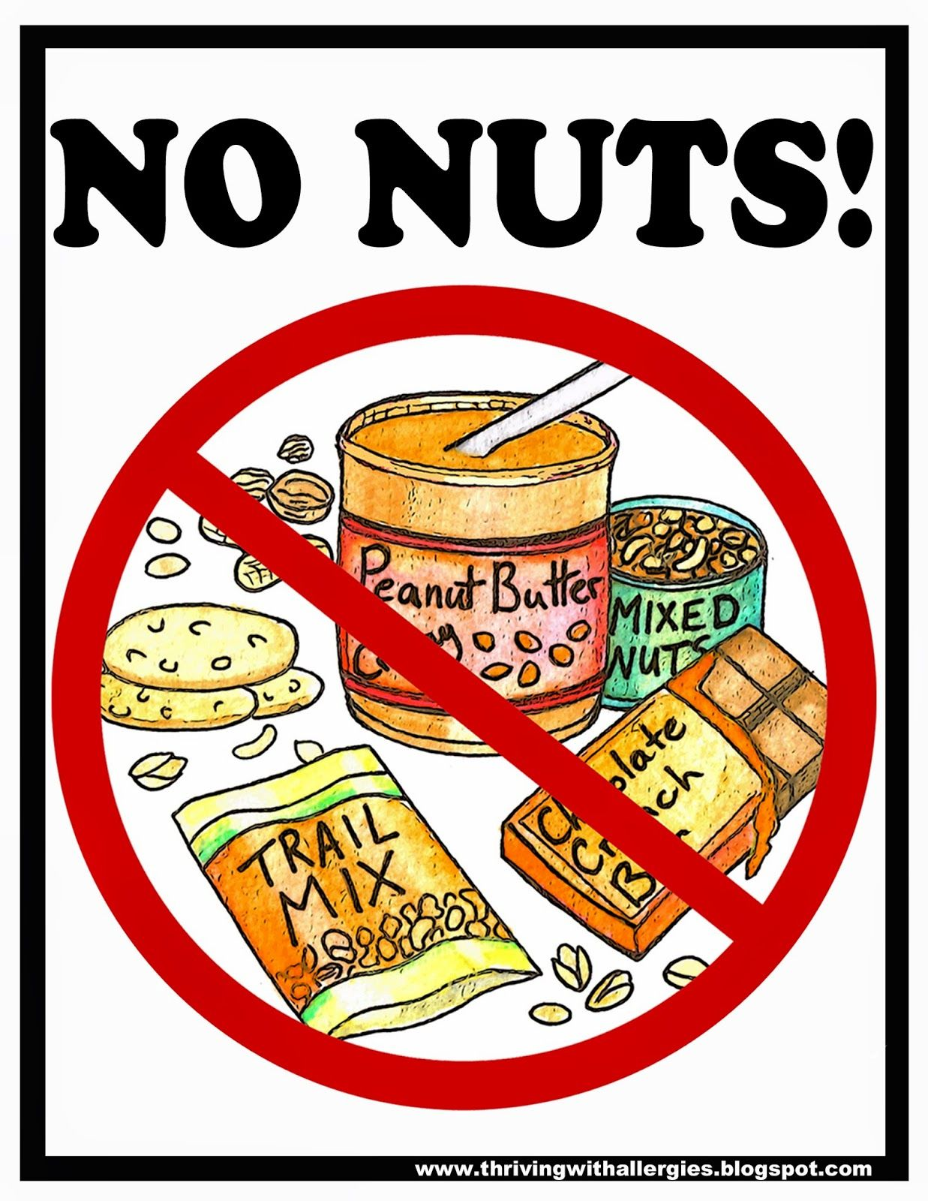
The Rise School
is a
Nut free school

Slide 2
An allergy is a reaction your body has to a particular food or substance.
There are many different types of allergies. Some are more common than others.
Common types of allergy are:
Foods, such as nuts, milk and gluten (food allergy)
Tree and grass pollen (hay fever)
Animal fur, particularly from pets like cats and dogs.
Insect stings, such as bee and wasp stings.
House dust mites.
Certain medicines.

Slide 3
Allergies can occur if someone:
- consumes the things that they are allergic to.
- touches the things that they are allergic to.
- has the things that they are allergic to in their environment.

Slide 4
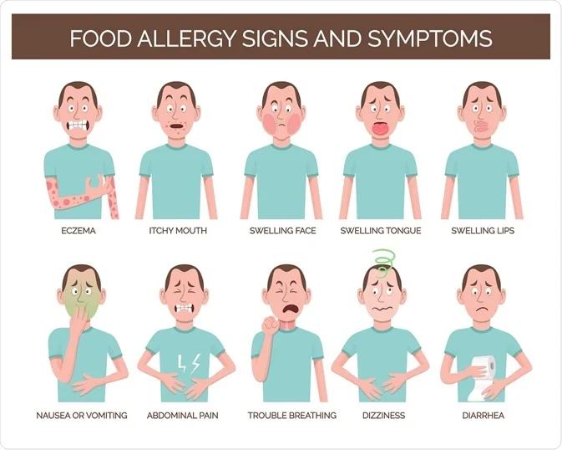
There are many different signs for allergies:
These can be life threatening.

Slide 5
At the Rise School, we have some people with severe nut and peanut allergies.
It is all our duty to keep these people safe at School.

Slide 6
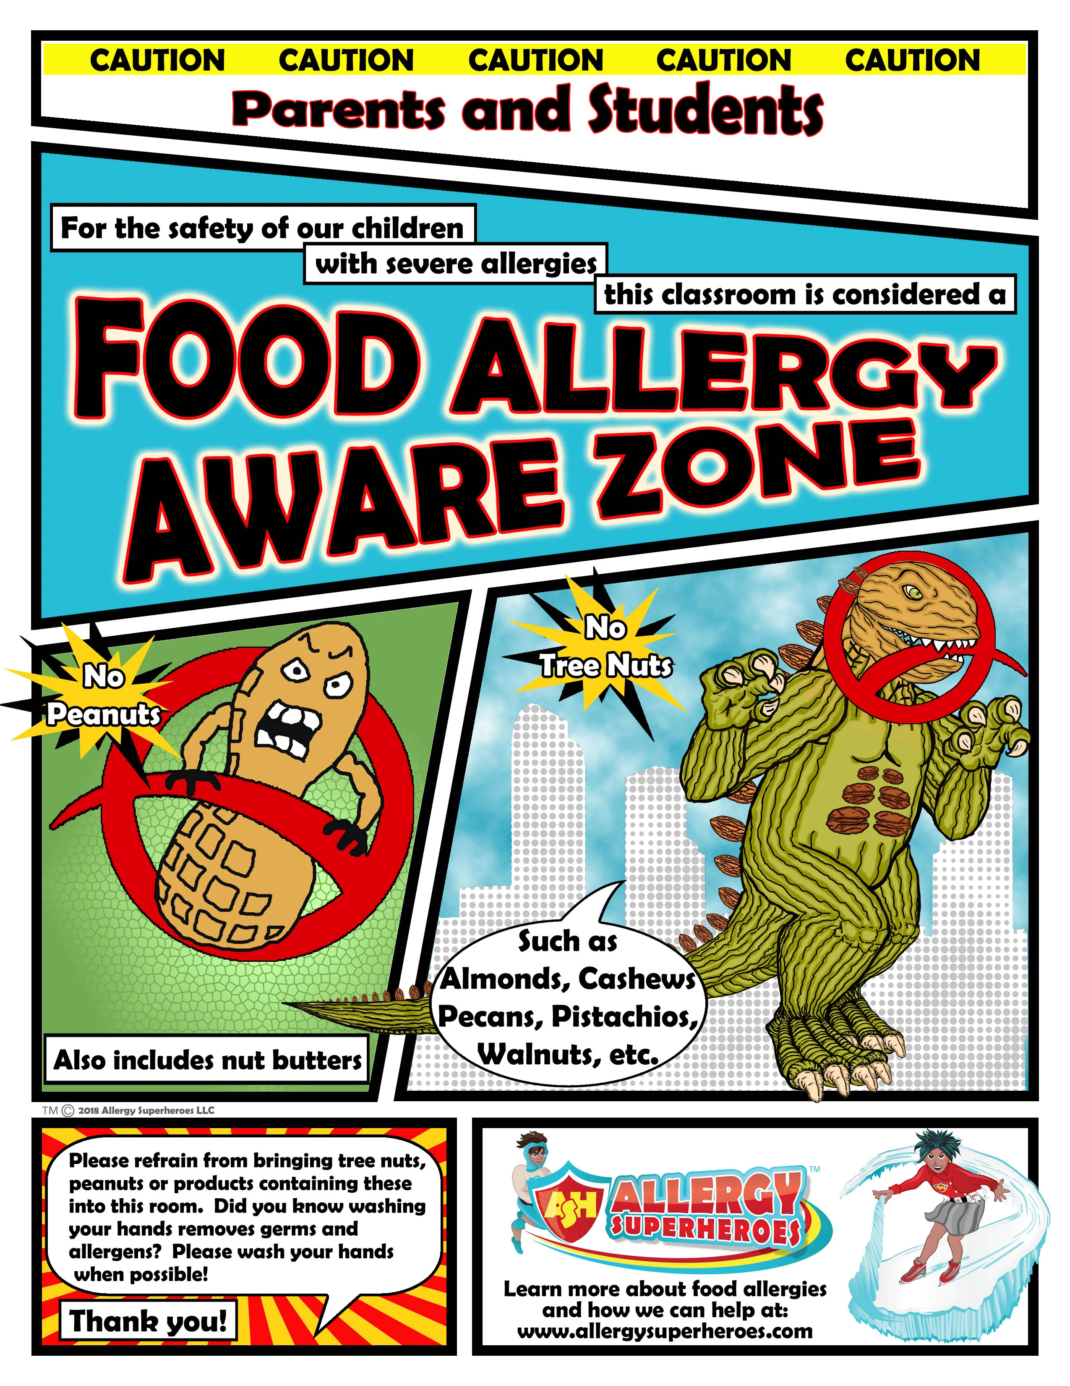
We can do this by remembering to check that we are not bringing any nut or peanut products into school.

Slide 7
The Rise School
is a
Nut free school

