Slide 1
KS2 Reading List
https://www.explorelearning.co.uk/blog/recommended-reading-lists/ (Lists for Year 1 – Year 6)

Slide 2
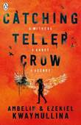
KS3-4 Reading List
https://www.booktrust.org.uk/books/
http://www.carnegiegreenaway.org.uk/
www.lovereading4kids.co.uk
www.ukchildrensbooks.co.uk
www.readingmatters.co.uk
www.cool-reads.co.uk

